Slide 1


Slide 2


Orientation

Slide 3

GROUND RULES
During Session
Attendance will not be given if you come after 5 minutes.
Every session quiz will be conducted in the first 10 minutes based on the portions covered in the previous class.
Using gadgets inside the classroom is not encouraged.

Slide 4

ATTENDANCE
Maintain 75 percentage of attendance.
Pay attention while taking attendance to avoid any issues.
In case of any issues with respect to attendance mail to vit.helpdesk@ethnus.com
Attendance gets blocked on every Monday. No changes will be made after that even for the valid reason.

Slide 5

ASSESSMENTS
Internal Assessment I – 15 Marks
Internal Assessment II – 15 Marks
CAT -1 – 15 Marks
CAT -2 – 15 Marks
FAT – 40 Marks
NOTE: Assessments will be conducted offline in respective class rooms
CAT and FAT exams will be conducted in Labs.

Slide 6
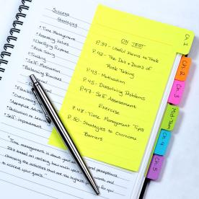
MATERIALS
Materials will be provided on course page(VTOP Portal)
Each topic will be provided with quiz link and practice questions.
Any doubts in attendance or marks mail to
vit.helpdesk@ethnus.com

Slide 7

SCAN TO REACH OUT TO US

Slide 8
ACTIVITY-1
LOGICAL REASONING

Slide 9
1. Jane's mother has four children. Their names are Spring, Summer, and Autumn. What is the fourth child's name?
Answer: "It is Jane because it got mentioned at the start of the question."

Slide 10
2. How many Ping pong balls fit into an aeroplane?
NOTE : How you approach the problem and what you inquire about is more important
Answer: "I require to first know the volume of a pingpong ball and the volume inside which specific plane is in question. Then I can divide the volume of the plane by the volume of one ball to give me an estimate of how many pingpong balls fit inside."

Slide 11
3. how much a pear costs if an apple is 40 rupees, a banana is 60 rupees and grapefruit is 80 rupees.
Answer: "In counting up the vowels of each fruit word, it looks like each vowel is 20 rupees, so a pear costs 40 rupees."

Slide 12
4. The day followed by the day after tomorrow is four days before Monday. What day is it today?
Answer: Here, Four days before Monday is Thursday, as four days after Thursday is Monday. Also, the day followed by the day after tomorrow is Thursday only if the present day is Monday.

Slide 13
5. Why are sewer hole covers round?
Answer. Sewer covers are round so that they are easy to use. There's no requirement to rotate them to put on. Also, they do not fall into the hole if they turn sideways. A square might cover diagonally.

Slide 14
ACTIVITY-2
PICTURE CONNECTION

Slide 15

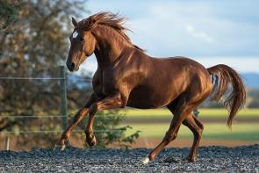
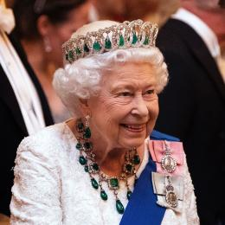


Slide 16
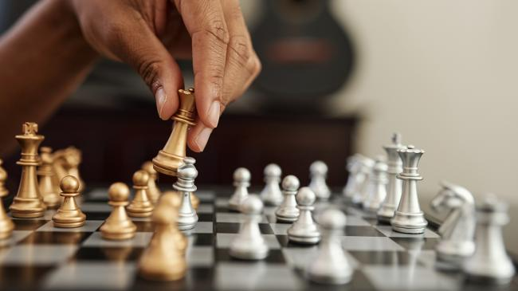
CHESS

Slide 17
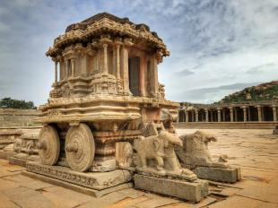

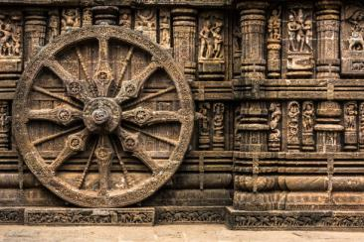
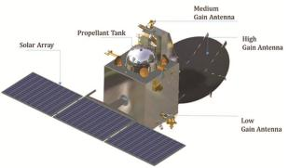

Slide 18
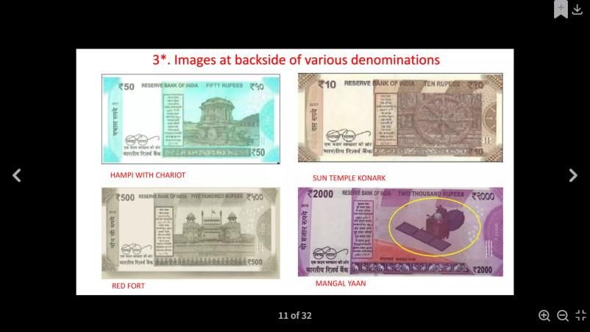

Slide 19
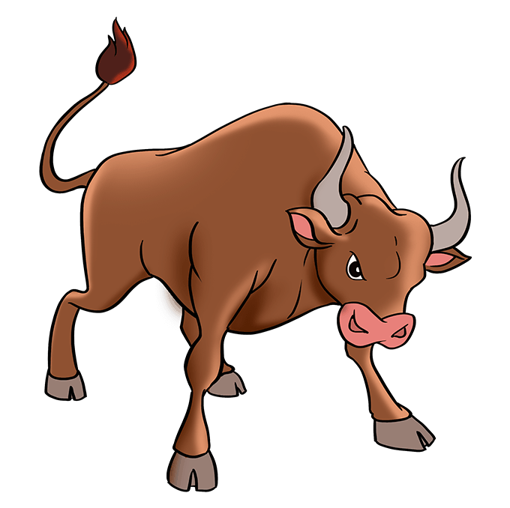
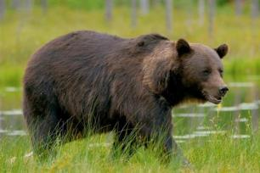

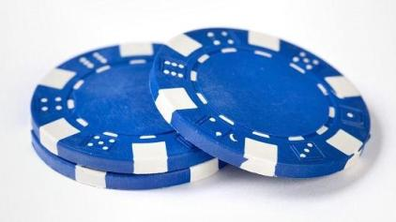

Slide 20

STOCK MARKET

Slide 21
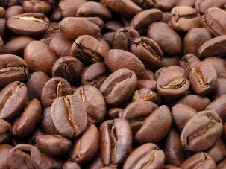
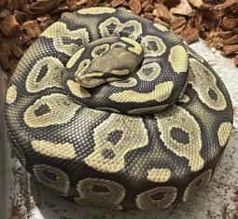



Slide 22

PROGRAMMING LANGUAGE

Slide 23





Slide 24
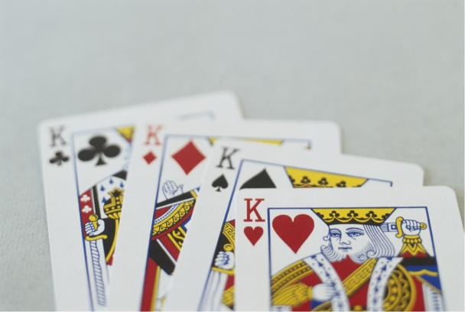
PACK OF CARDS

Slide 25


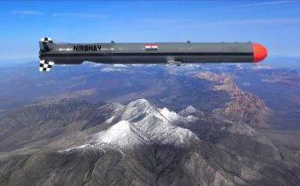
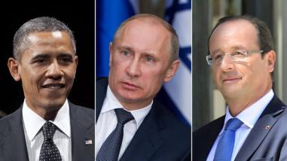

Slide 26
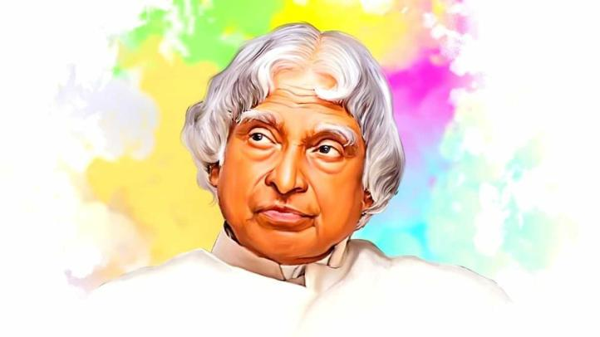
Dr. A. P. J. Abdul Kalam

Slide 27
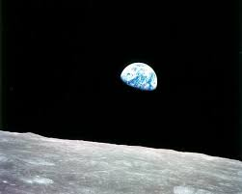
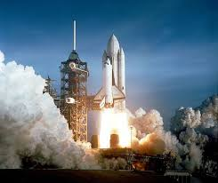

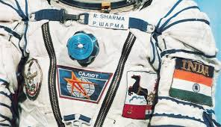

Slide 28
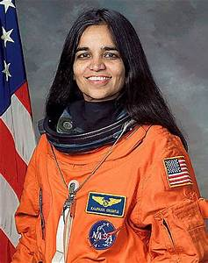
KALPANA CHAWLA

Slide 29
ACTIVITY-3
PUZZLE & RIDDLES

Slide 30
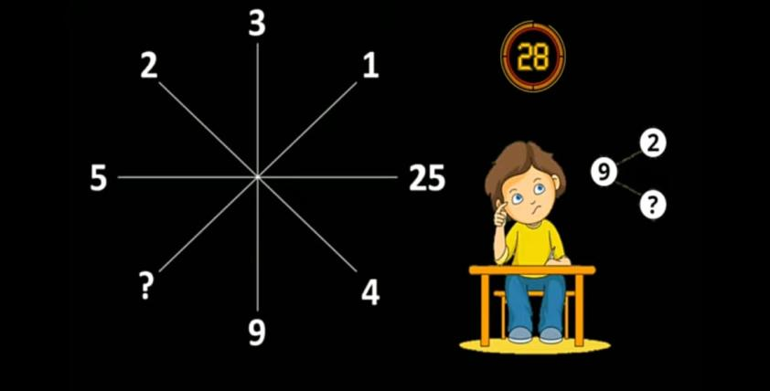

Slide 31
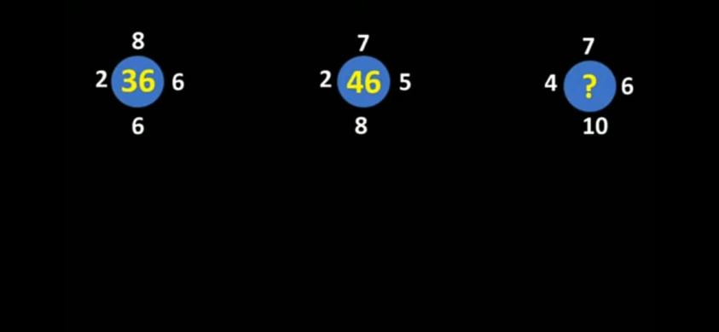

Slide 32
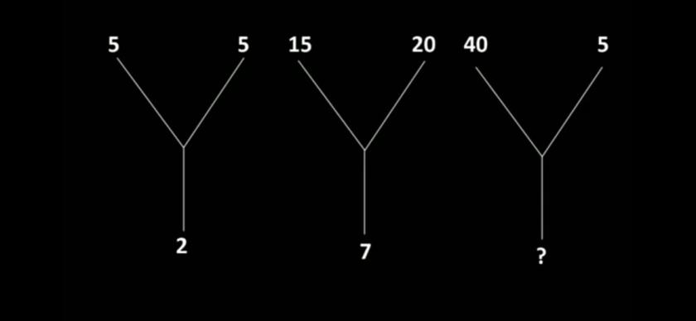

Slide 33
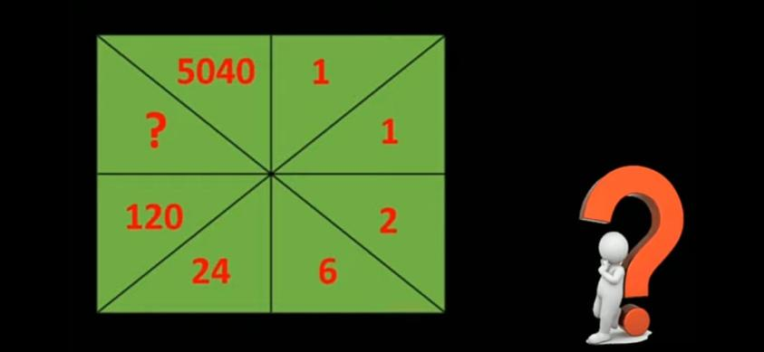

Slide 34
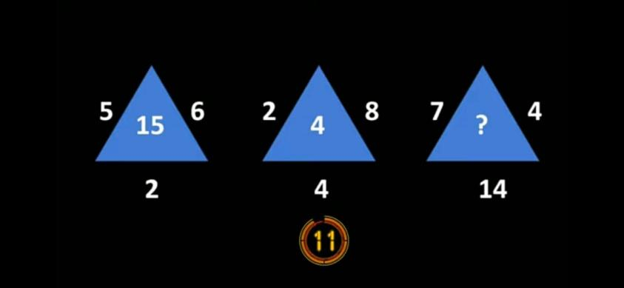

Slide 35
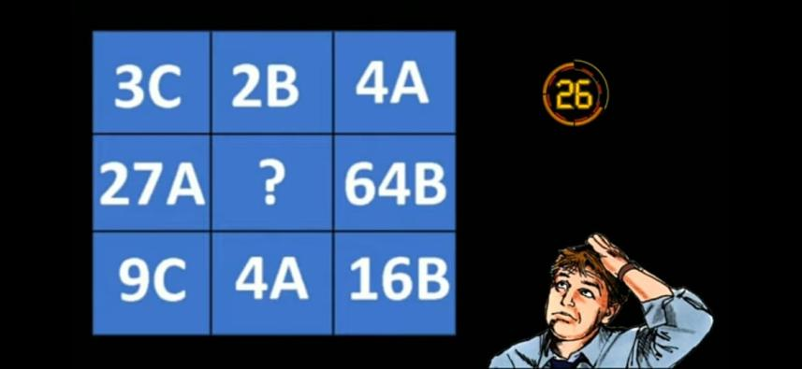

Slide 36
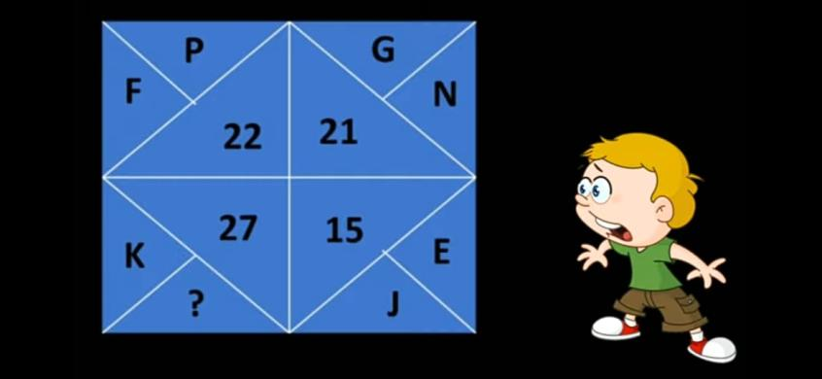

Slide 37
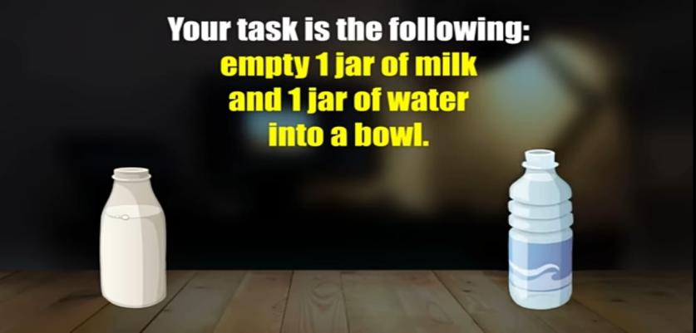

Slide 38
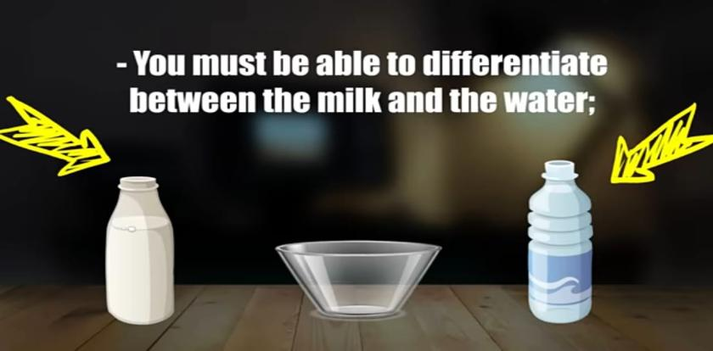

Slide 39


Slide 40


Slide 41
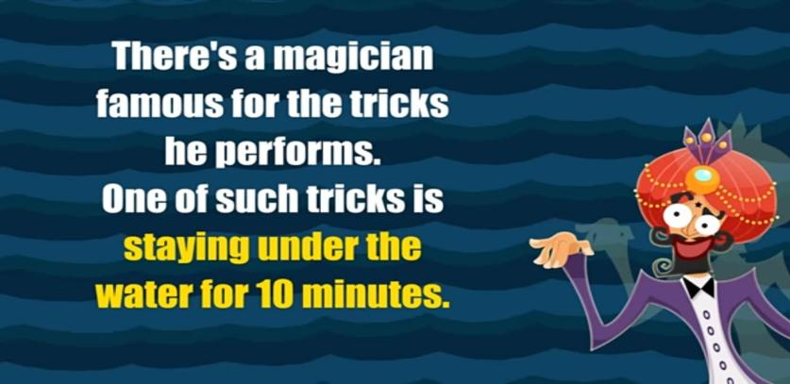

Slide 42
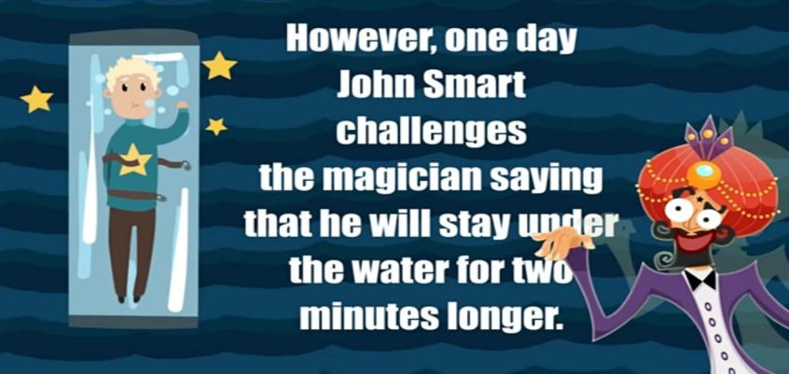

Slide 43


Slide 44


Slide 45
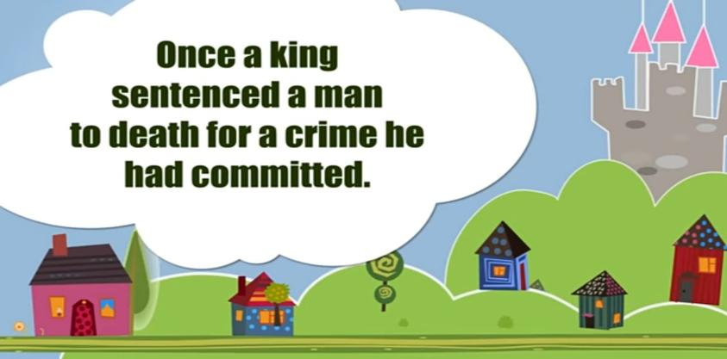

Slide 46
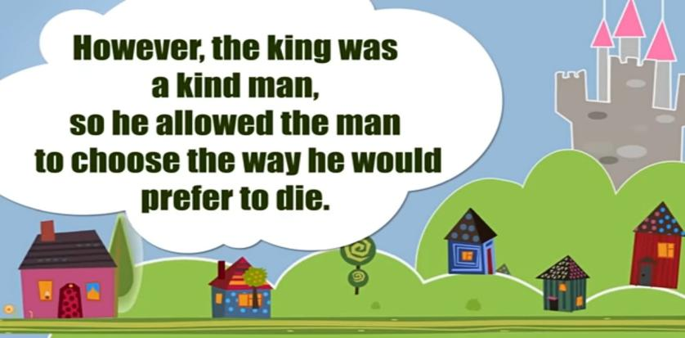

Slide 47
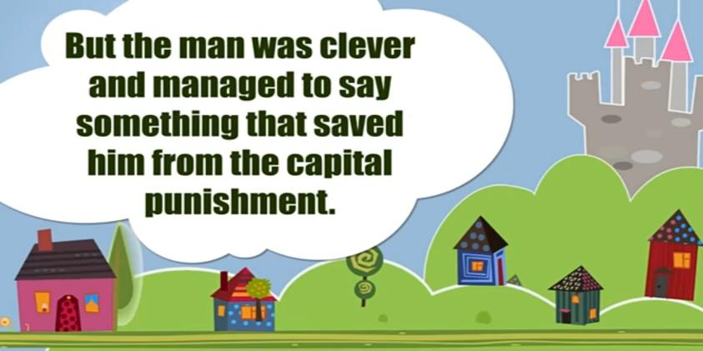

Slide 48







/ethnuscodemithra
Ethnus Codemithra
/ethnus
/code_mithra
THANK YOU
https://learn.codemithra.com/
codemithra@ethnus.com
+91 7815 095 095
+91 9019 921 340

